Slide 1
STACK EXCHANGE API · SQLITE · BM25
PHASE 1 — 3
Semantic Similar-Question Recommender for C++ on Stack Overflow
Introduction to Data Science — Final Project, Phases 1 to 3
team members: Sajjad Taghizadeh- Sadegh Samadi- Deniz Mostafazadegan
Instructor: Prof Razavi & Yagoobzadeh
Stack Overflow C++ Recommender

Slide 2
Problem and Motivation
OVERVIEW
Thousands of C++ questions on Stack Overflow are duplicates or near-duplicates of questions already answered.
Given any C++ question, return a ranked list of the closest earlier questions.
Duplicate detection
Related-questions widget
Route to an answer
Flag new questions that repeat an existing thread.
Surface neighbours next to any question page.
Send the asker to an existing solution first.
Stack Overflow C++ Recommender
02

Slide 3
Dataset at a Glance
OVERVIEW
26,162
5,572
2008–26
C++ questions
unique tags
years covered
Source: official Stack Exchange API
Collected with our own crawler
Each record stores the title, HTML body, tags, view / answer / vote counts, and creation date.
Stack Overflow C++ Recommender
03

Slide 4
Project Roadmap
OVERVIEW
PHASE 1
PHASE 2
PHASE 3
Data collection
Database and pipeline
Model and deployment
Resumable crawler over the c++ tag on the Stack Exchange API.
Normalised SQLite schema, EDA, reproducible pipeline with CI.
Seven candidate models, tuned BM25, predictions written back to the database.
→
→
Stack Overflow C++ Recommender
04

Slide 5
PHASE 1
Data Collection
From 2,500 seed questions to 26,162

Slide 6
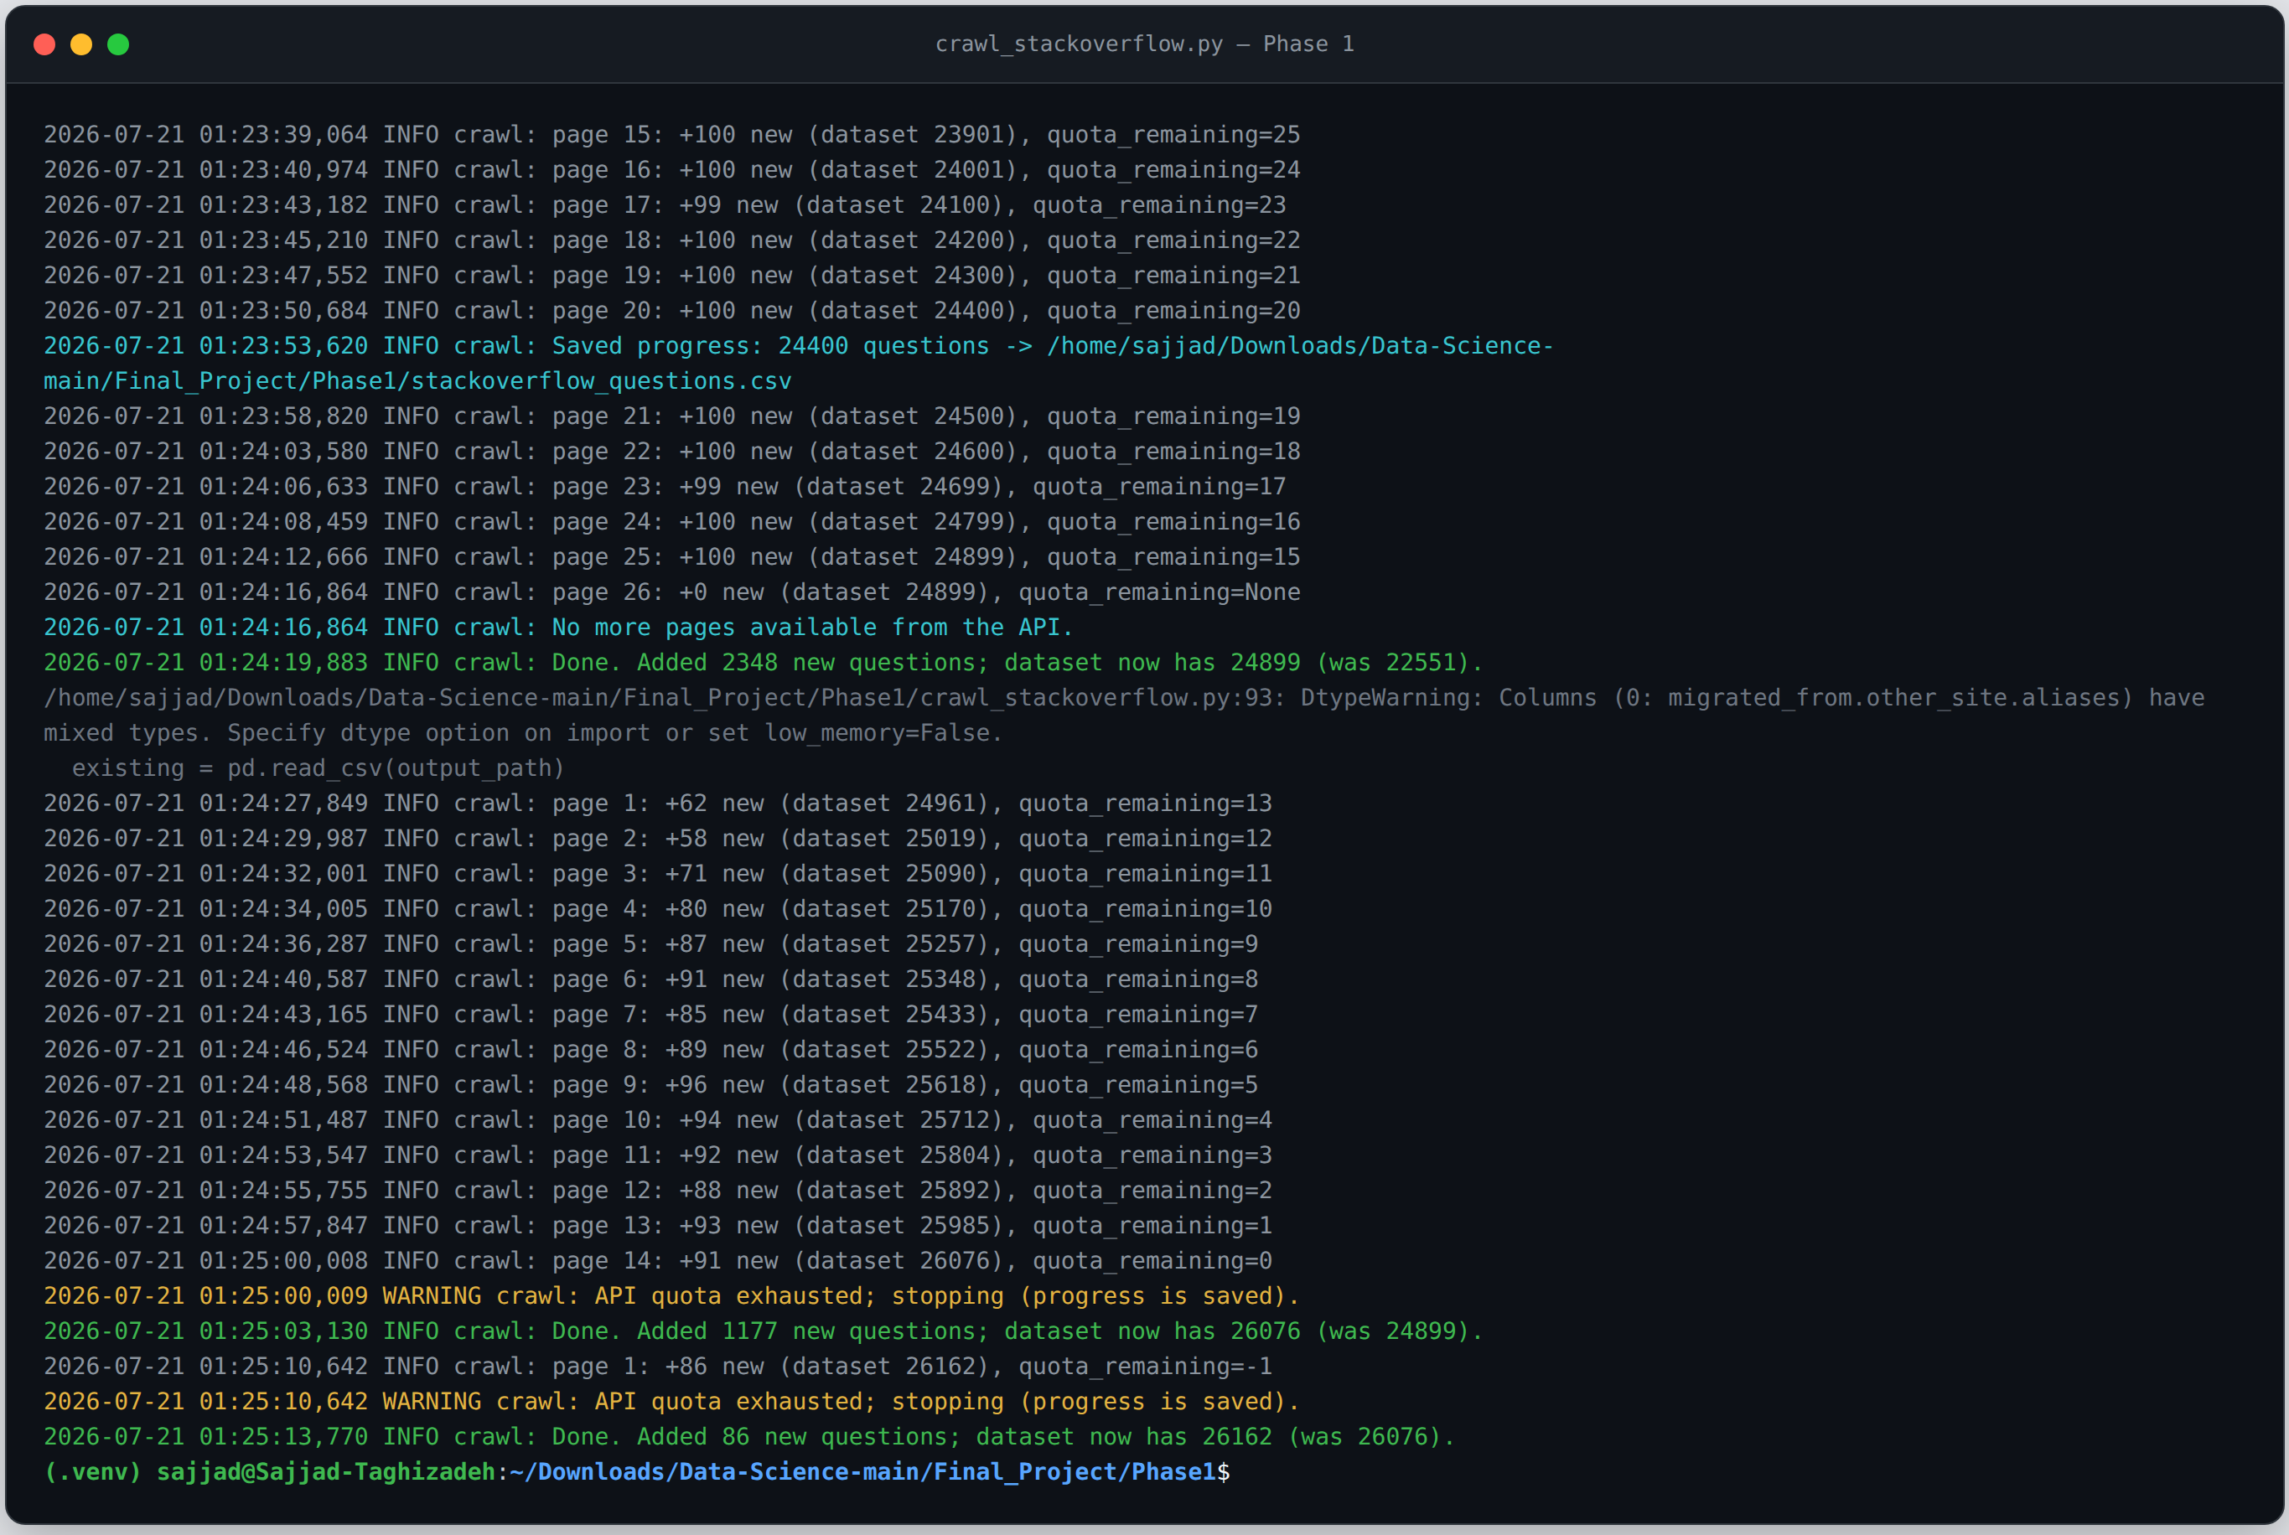
The Crawler
PHASE 1
crawl_stackoverflow.py
—
Paginates the official API by the c++ tag.
—
Resumable: skips already-seen IDs and saves incrementally.
—
No API key required — about 30,000 questions per day.
screenshot: terminal output of crawl_stackoverflow.py
26,162
questions collected, up from 2,500
Stack Overflow C++ Recommender
06

Slide 7
PHASE 2
Database and Pipeline
Normalised storage, technical-text cleaning, reproducible runs

Slide 8
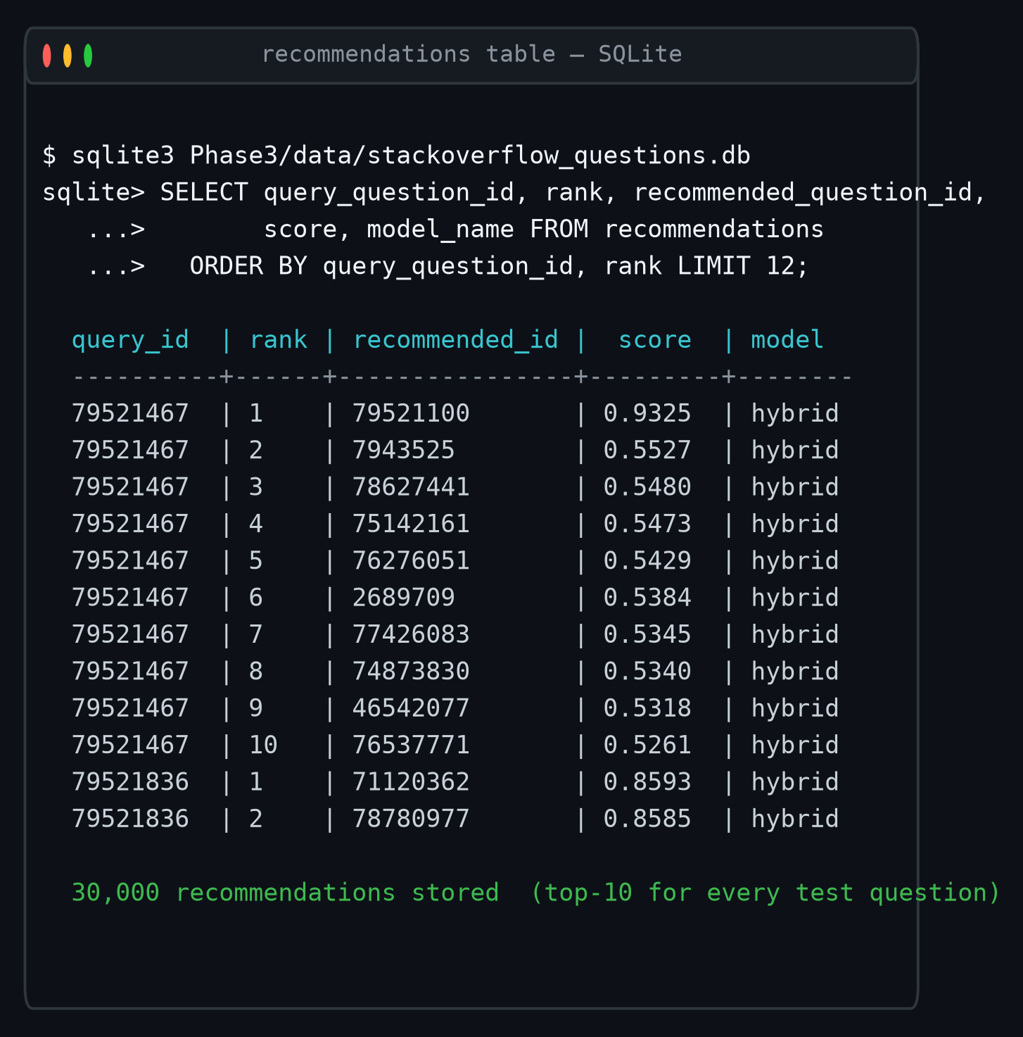
Database Schema
PHASE 2
users
1 : N
user_id · display_name · reputation
questions
question_id · title · body · score · views · created_at · user_id (FK)
question_tags
N : M
question_id (FK) · tag_id (FK)
screenshot: SQL query output from notebook section1
tags
tag_id · tag_name (unique)
FOREIGN KEYS
CONSTRAINTS
INDEXES
Stack Overflow C++ Recommender
08

Slide 9
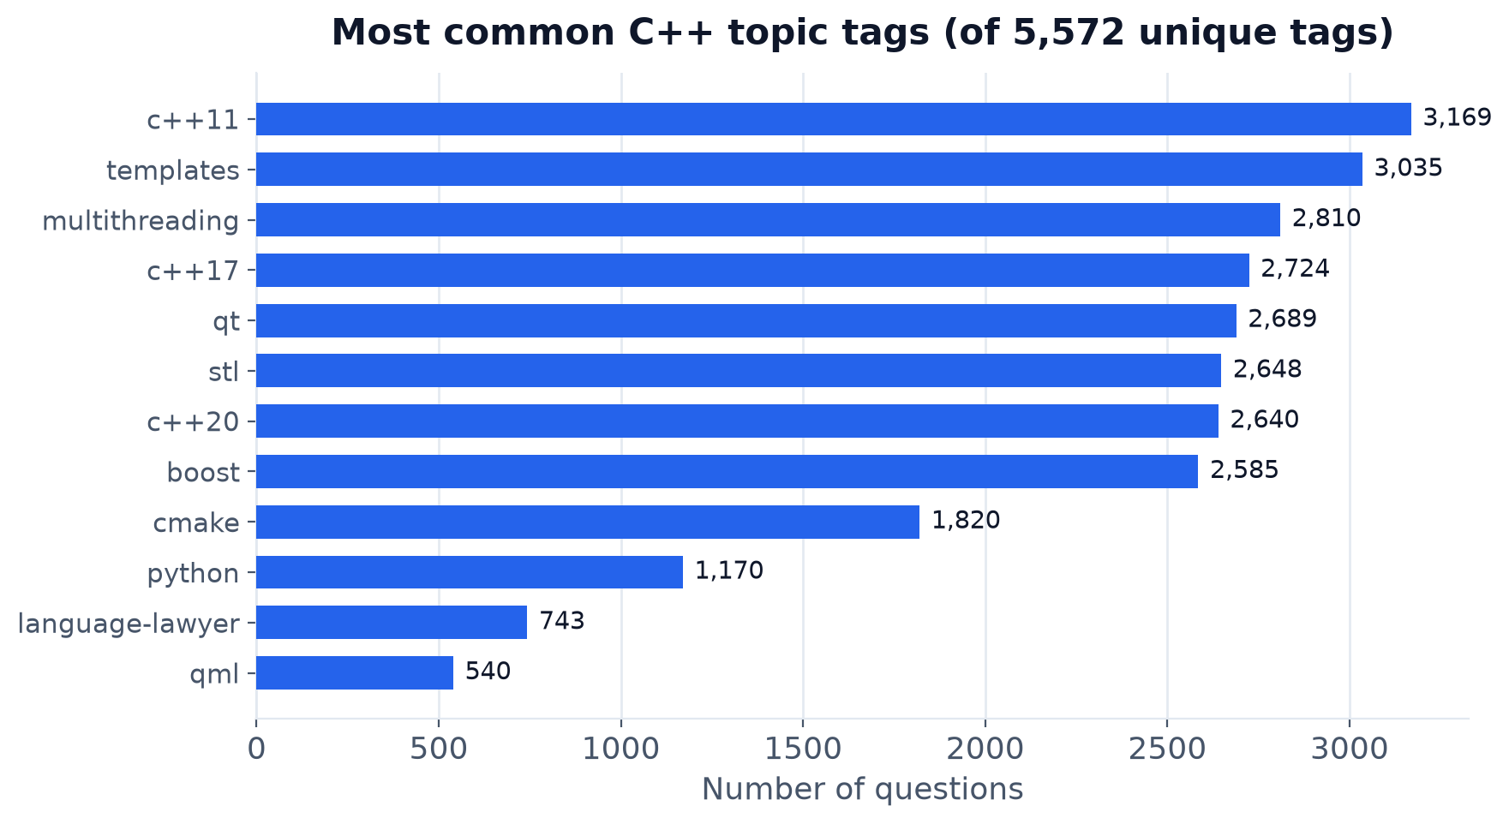
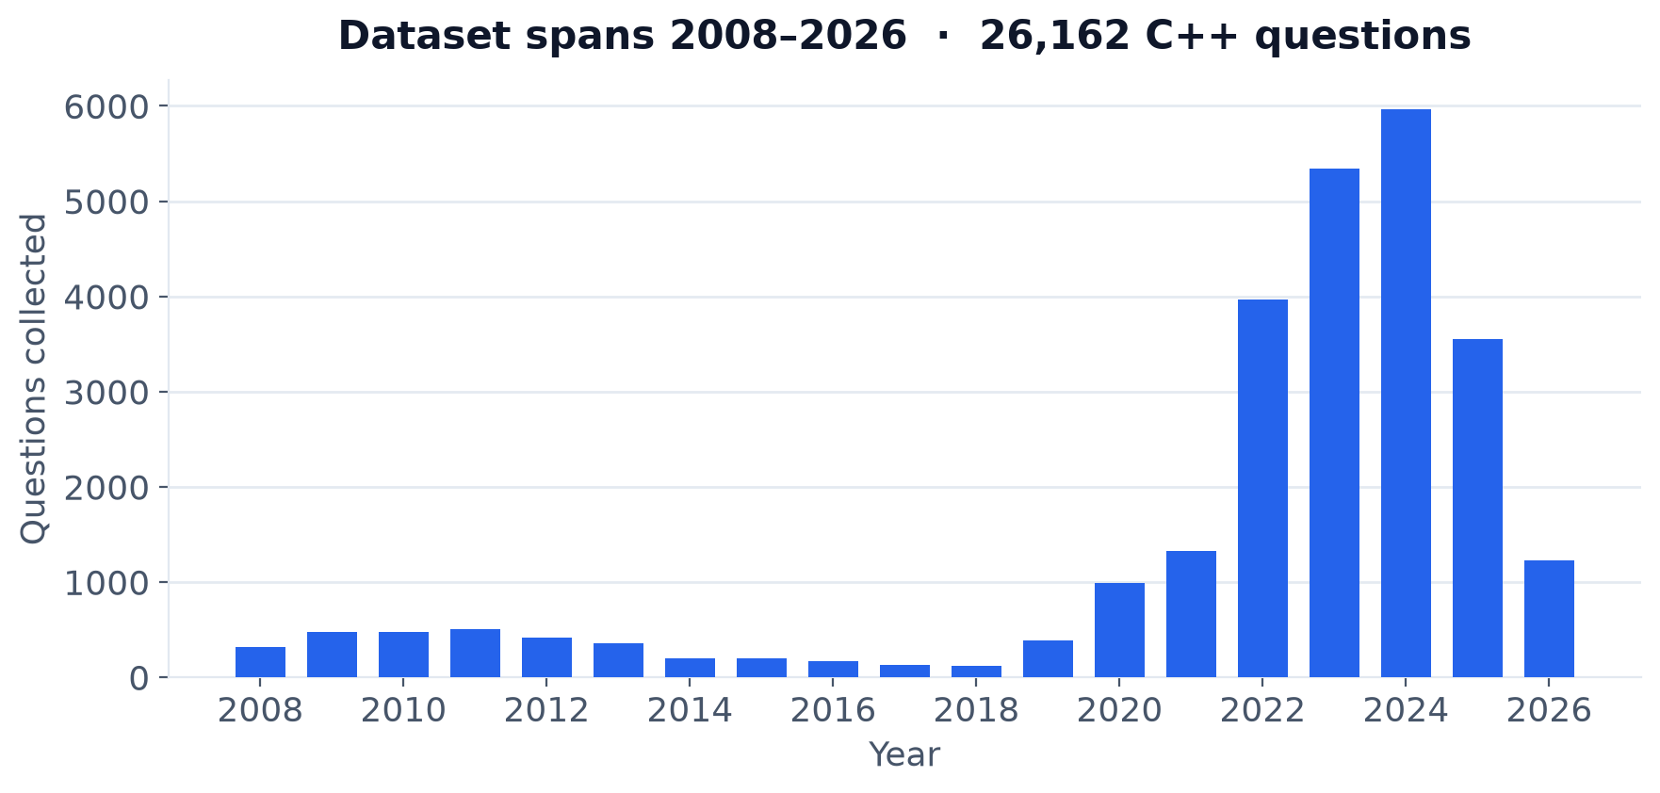
EDA and Preprocessing
PHASE 2
—
Technical-text cleaner removes HTML but keeps std::vector and code-block markers.
—
Tag, volume and activity distributions profiled per year.
—
Temporal split so training never sees future questions.
screenshot: EDA charts from notebook section2
train 18,313 · validation 3,000 · test 3,000
Stack Overflow C++ Recommender
09

Slide 10
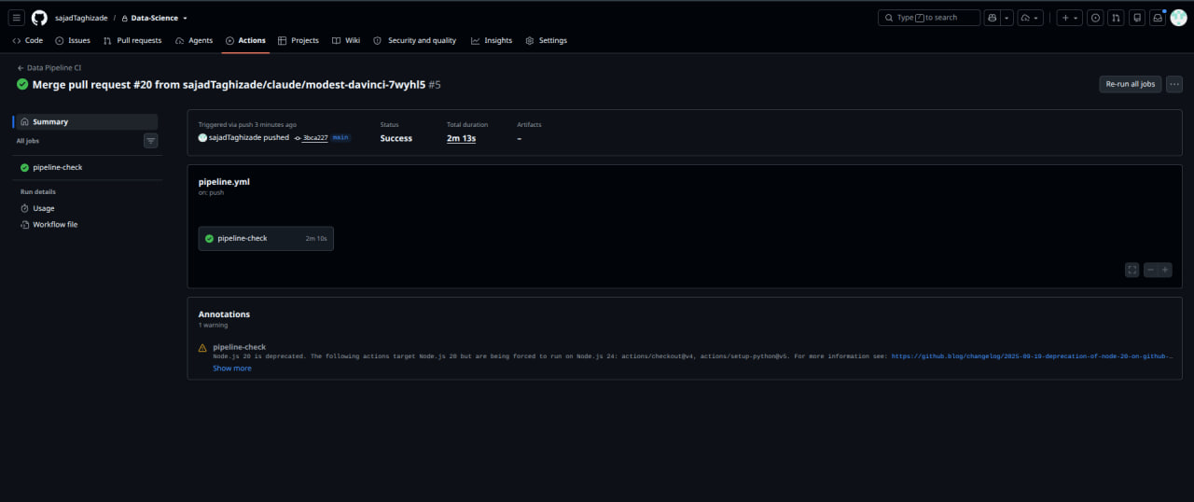
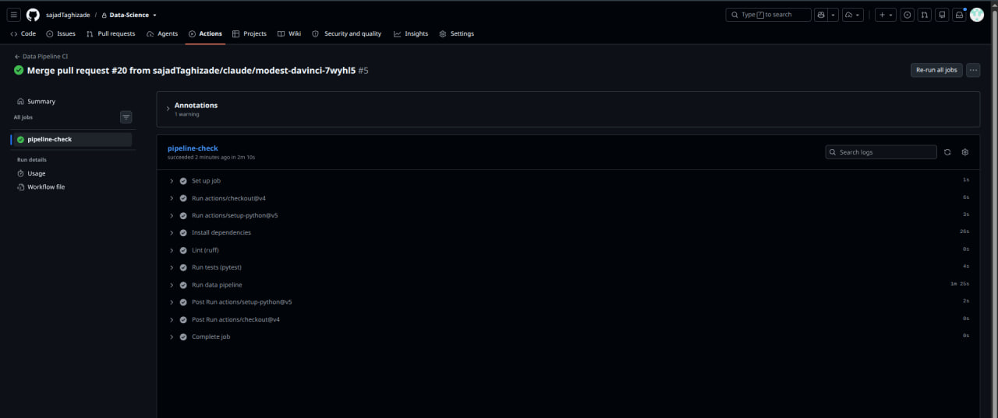
Pipeline, CI/CD and MLOps
PHASE 2
Pipeline
Continuous integration
Containers
pipeline.py
GitHub Actions · ruff · pytest
Dockerfile · Minikube Job
One command reproduces ingest, clean and split.
Lint and 30 unit tests on every push.
Same run locally and on Kubernetes.
Stack Overflow C++ Recommender
10

Slide 11
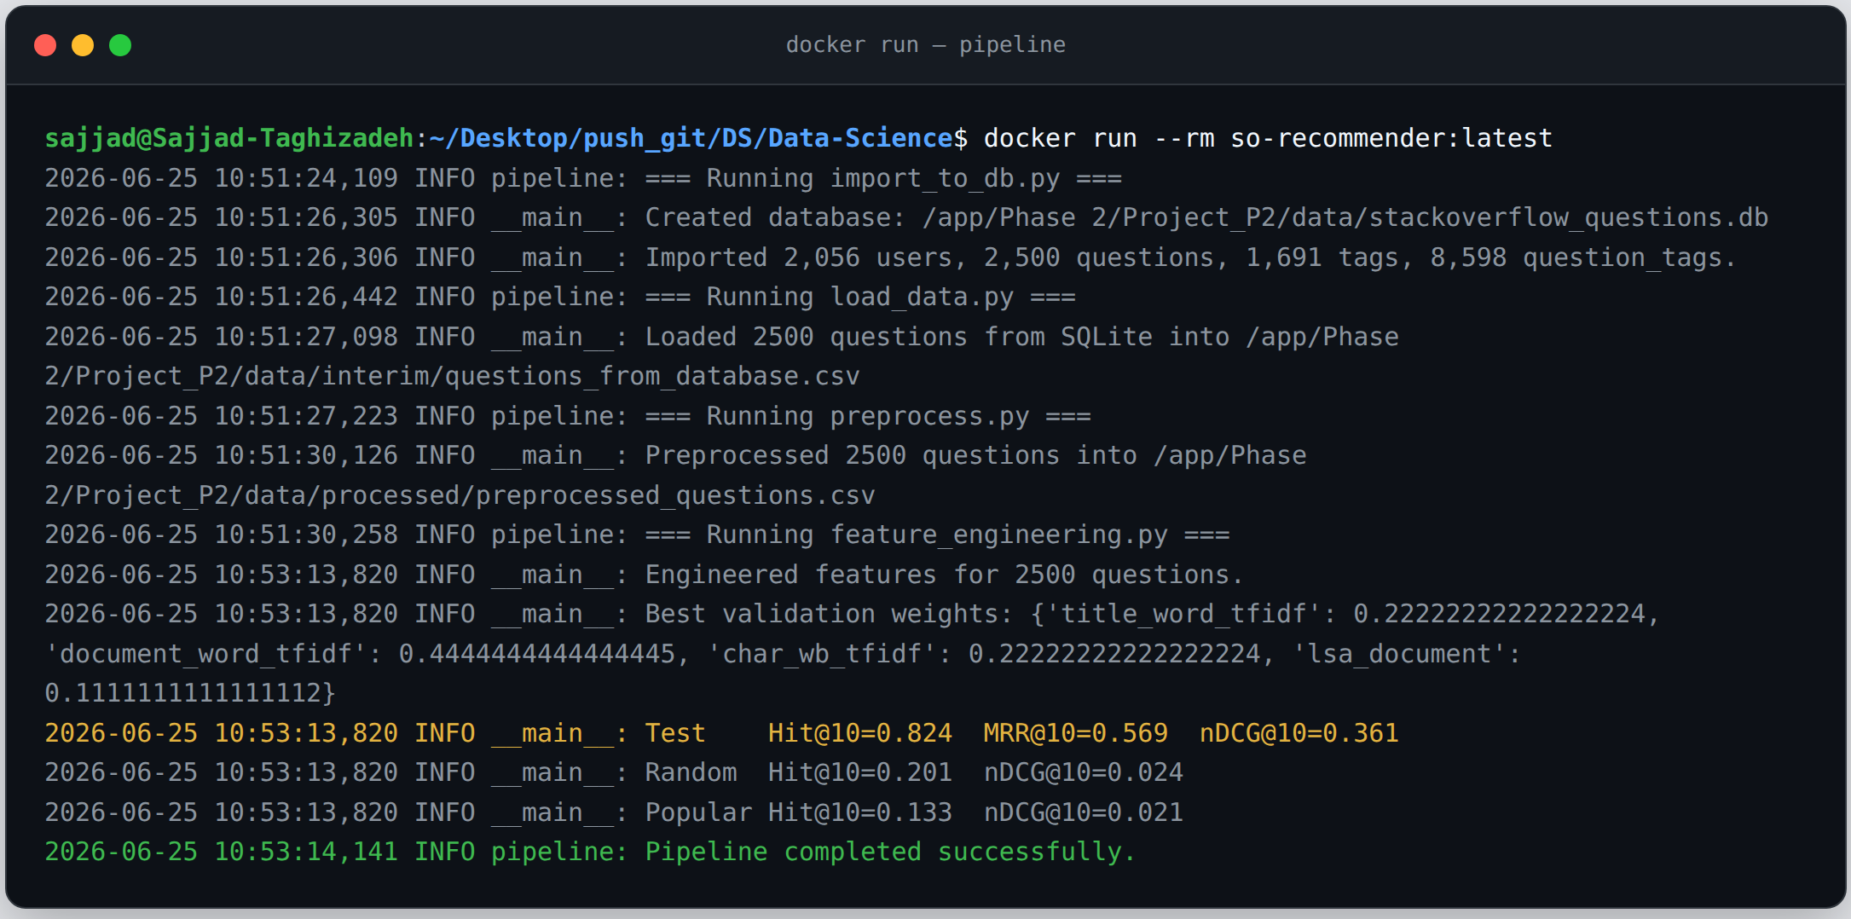
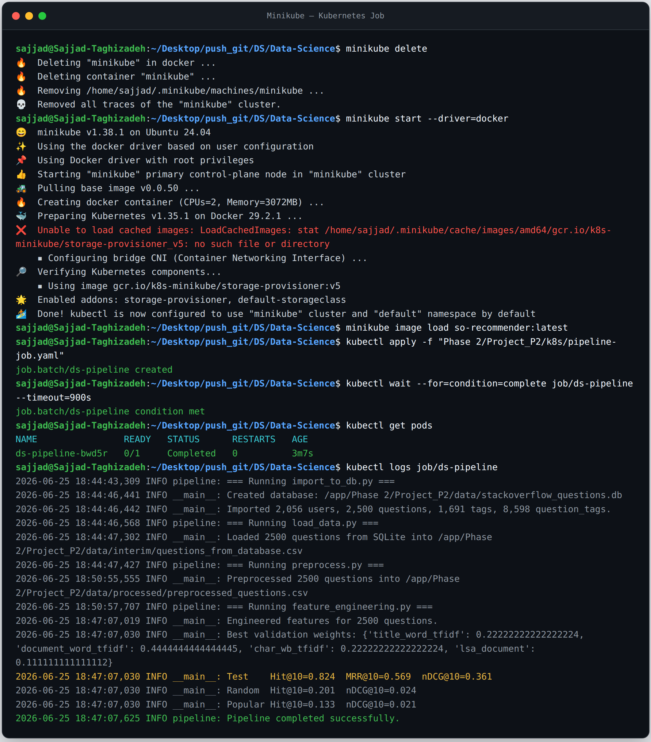
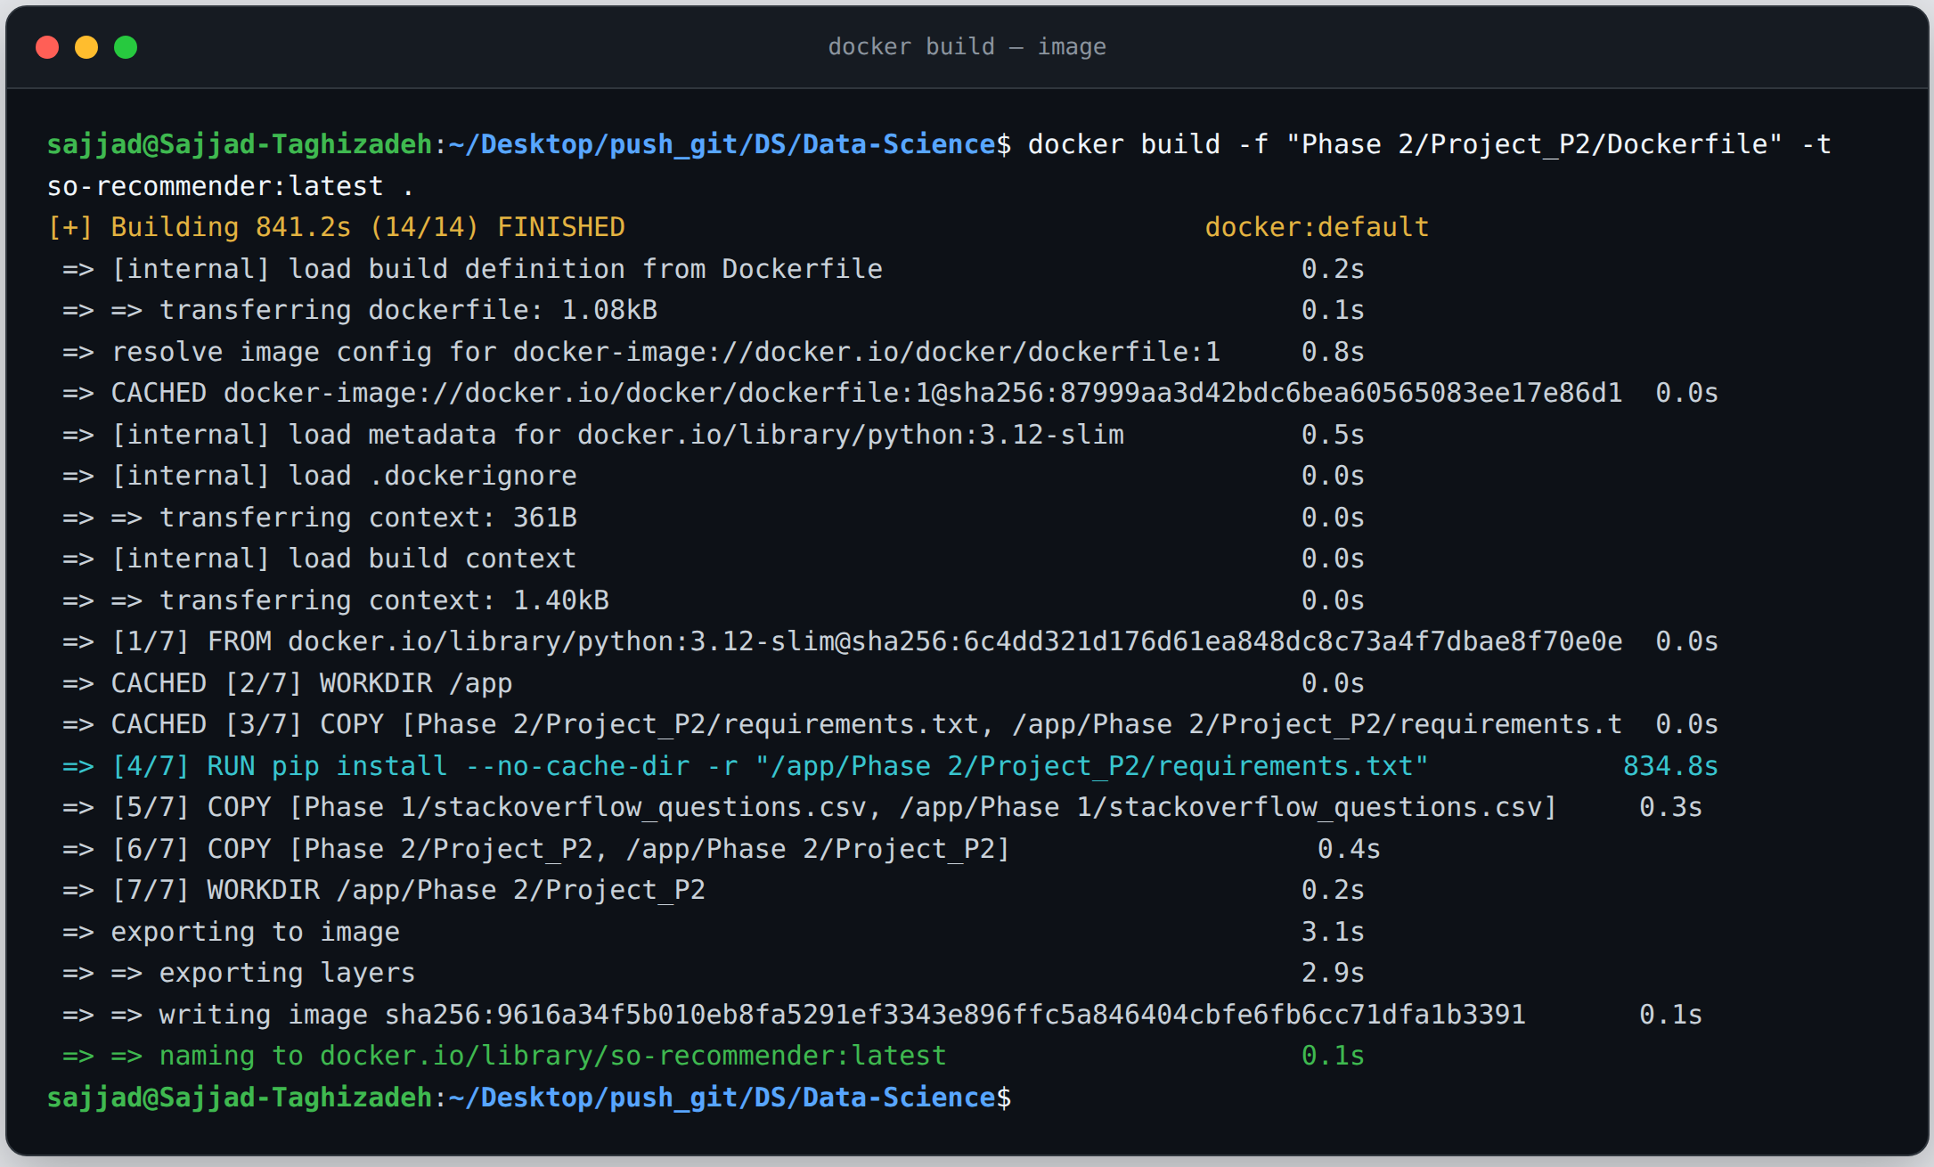
Pipeline, CI/CD and MLOps
PHASE 2
Stack Overflow C++ Recommender
11

Slide 12
PHASE 3
Model Development and Evaluation
Seven candidates, cross-validated selection, one test run

Slide 13
Candidate Models and Selection Method
PHASE 3
title_word_tfidf
document_word_tfidf
Temporal split
18,313 / 3,000 / 3,000
char_wb_tfidf
lsa_document
Selection
5-fold CV on nDCG@10
bm25_document
document_prf
Leakage controls
hybrid — weighted combination
Time-ordered split · vectorisers fit on train only · model chosen on CV · test set evaluated exactly once.
BM25 implemented from scratch; document_prf adds Rocchio query expansion.
Stack Overflow C++ Recommender
13

Slide 14
Model Selection Results
PHASE 3
CV nDCG@10 on validation
hybrid
0.759
char_wb_tfidf
0.739
bm25_document
0.726
lsa_document
0.705
document_prf
0.681
document_word_tfidf
0.676
title_word_tfidf
0.376
BM25 tuned to k1 = 2.0, b = 0.9; the char n-gram model contributes most to the hybrid.
Stack Overflow C++ Recommender
14

Slide 15
Test Results and Baseline Comparison
PHASE 3
Hit@10 vs. baselines
0.893
0.893
Hit@10 on unseen test data
Hit@5
0.836
0.376
Hit@20
0.931
0.105
MRR@10
0.710
Hybrid
Random
Popularity
nDCG@10
0.559
Coverage
95.5%
Stack Overflow C++ Recommender
15

Slide 16
Two-Pipeline Architecture
PHASE 3
train_pipeline.py
load
→
preprocess
→
fit models
→
save model
predict_pipeline.py
load model
→
preprocess
→
retrieve top-K
→
write to DB
screenshot: recommendations table in the database (sqlite3 output)
30,000
recommendations in the recommendations table
run_pipeline.py runs both stages end to end
Stack Overflow C++ Recommender
16

Slide 17
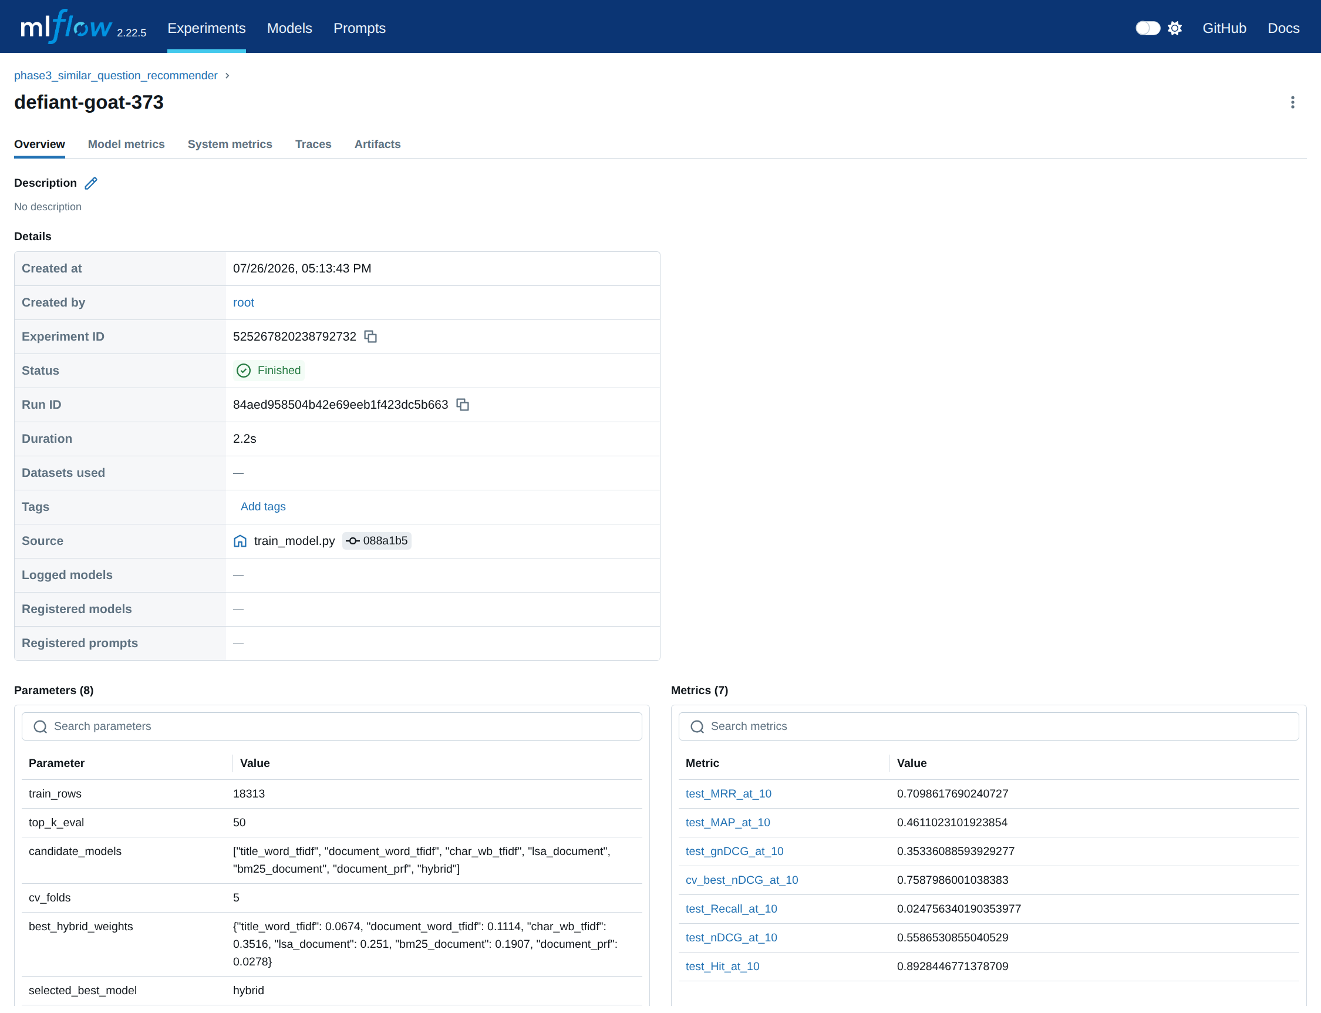
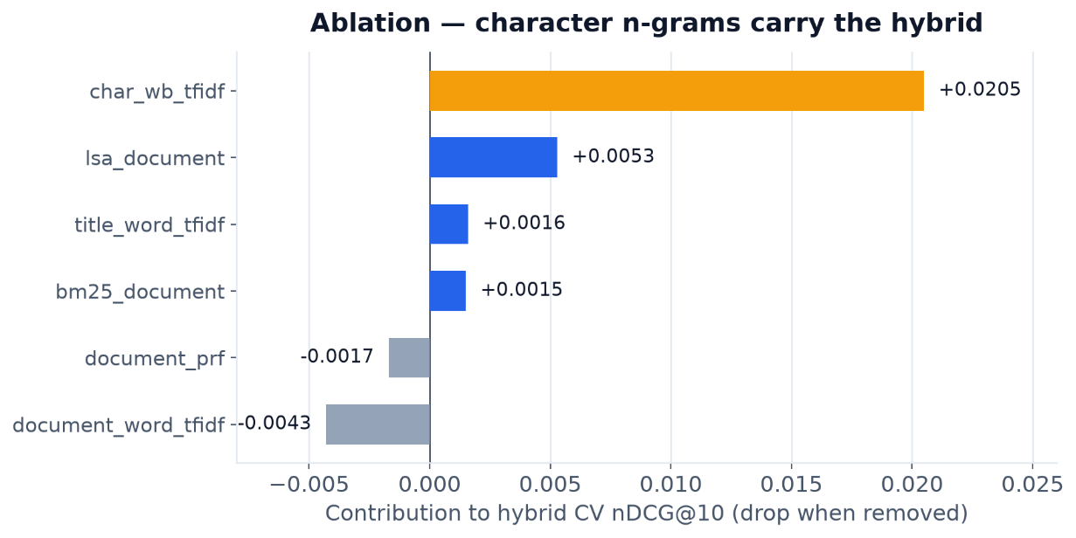
Improvements and Experiment Tracking
PHASE 3
BM25 tuning
Pseudo-relevance feedback
k1 = 2.0, b = 0.9
Rocchio expansion
Graded metric
Diversity re-ranking
gnDCG
MMR
Ablation study
Error analysis
char n-gram dominates
+ interactive CLI
screenshot: MLflow UI (Metrics / Artifacts tab)
MLflow
every run, parameter and metric logged
Stack Overflow C++ Recommender
17

Slide 18
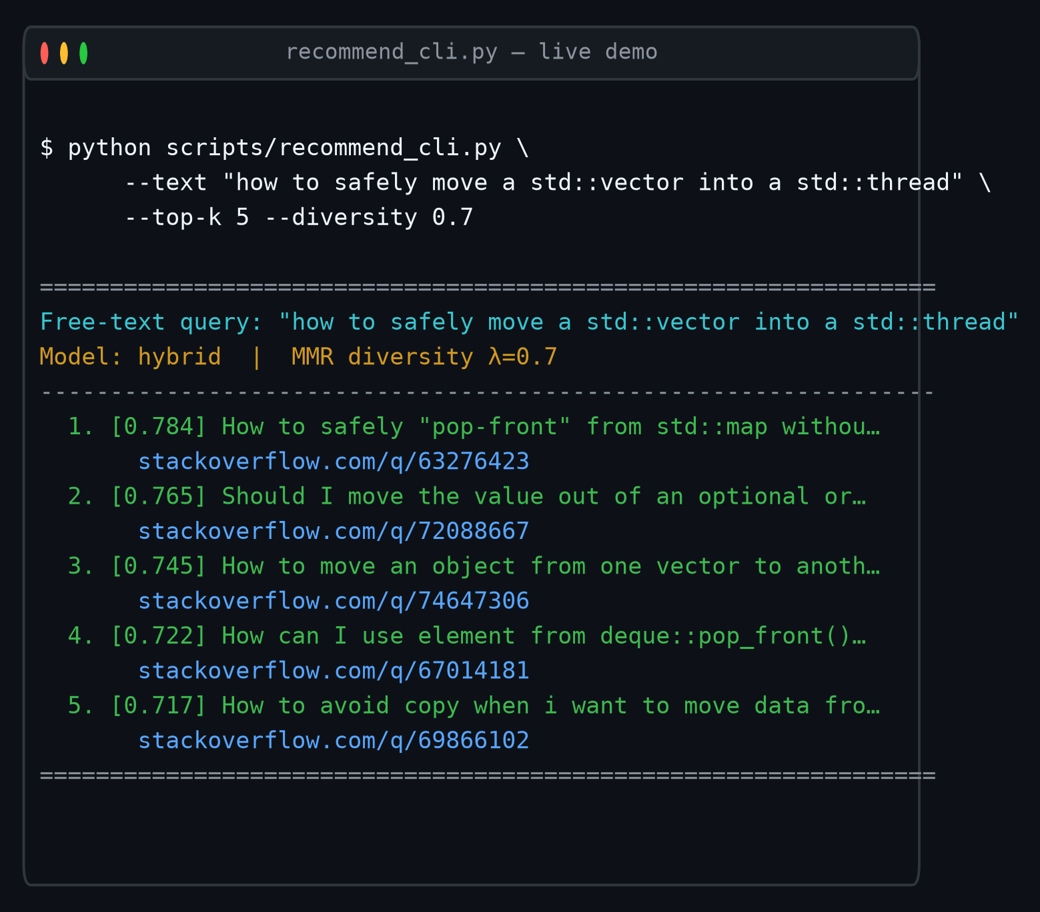
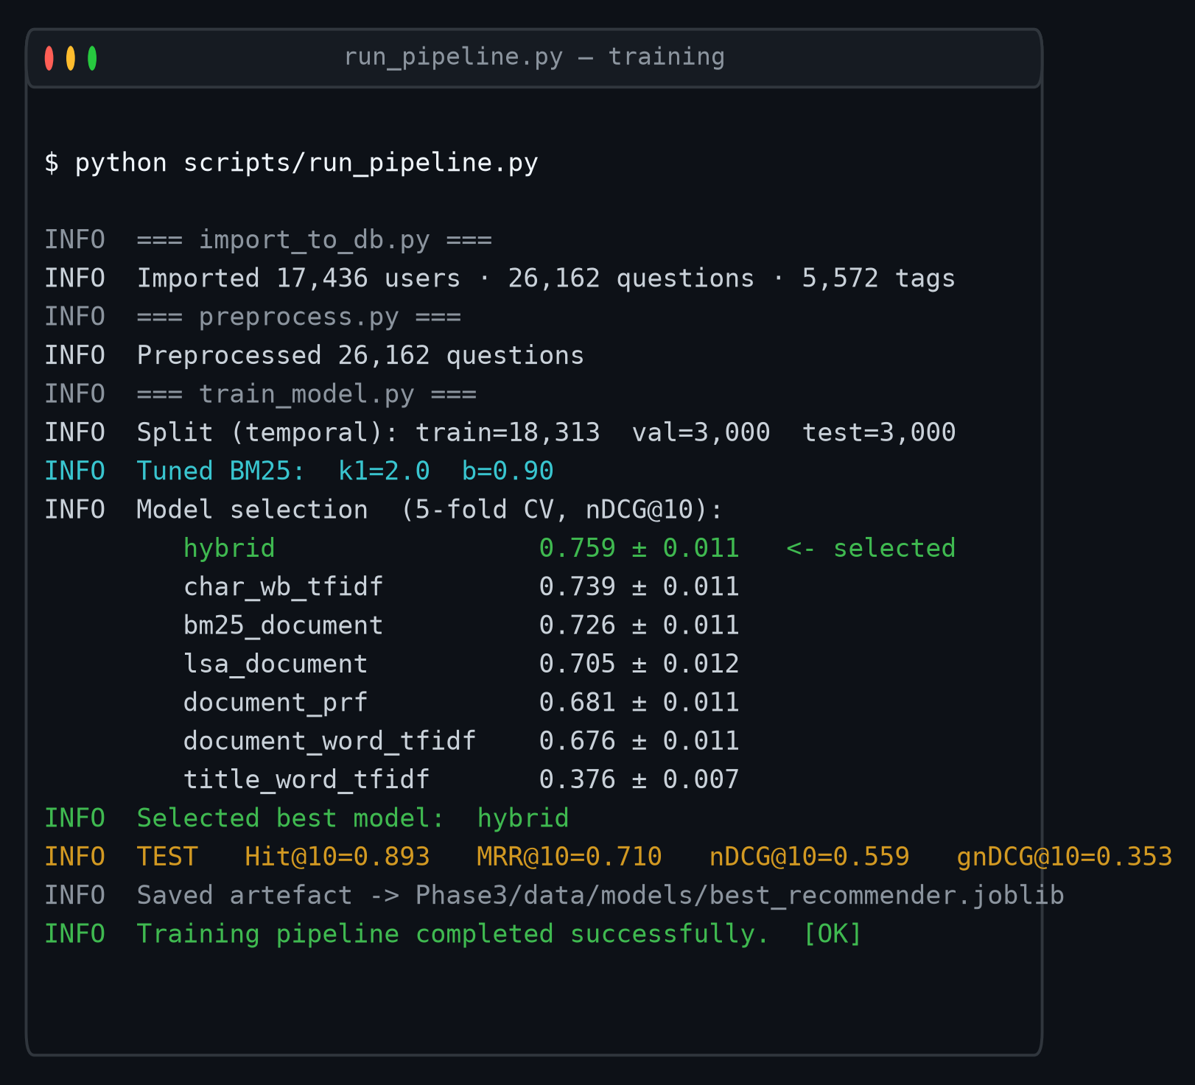
Live Demo
PHASE 3
recommend_cli.py
run_pipeline.py
screenshot: recommendation demo output
screenshot: terminal run through Hit@10 = 0.893 and 30000 recommendations
Stack Overflow C++ Recommender
18

Slide 19
Business Value, Limitations, Future Work
WRAP-UP
Business value
Limitations
Future work
Fewer duplicate threads reaching moderators.
Relevance labels are weak — derived from shared tags.
Add a neural embedding model to the hybrid.
A related-questions widget on every page.
Lexical models misread polysemous terms such as queue.
Scale the dataset and collect real user feedback.
Askers routed to an existing answer.
No neural embeddings in the current system.
Serve the recommender behind an API.
Stack Overflow C++ Recommender
19

Slide 20
Engineering Quality and Repository Structure
WRAP-UP
Final_Project/
Unit tests
30
├── Phase1_Data_Collection/ crawl_stackoverflow.py
├── Phase2_Database_Pipeline/ schema.sql · pipeline.py · notebooks/
Linting
ruff
├── Phase3_Model/ train_pipeline.py · predict_pipeline.py · run_pipeline.py
CI status
passing
├── tests/ 30 unit tests
├── Dockerfile · k8s/job.yaml
Docs
per-phase README
└── .github/workflows/ci.yml
Stack Overflow C++ Recommender
20

Slide 21
SUMMARY
An end-to-end recommender: our own crawler, a normalised database, and a tuned hybrid retrieval model serving predictions from the database.
26,162
0.893
30,000
questions collected
Hit@10 on unseen test data
recommendations stored
Thank you for your attention.
21

